Slide 1
MUC1-C Target Evaluation
Confidential 1

Slide 2
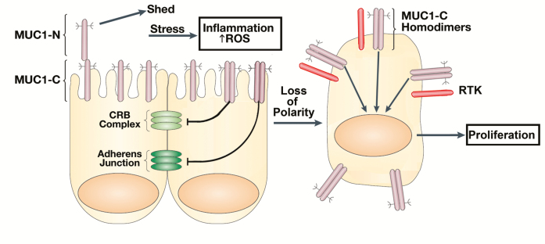
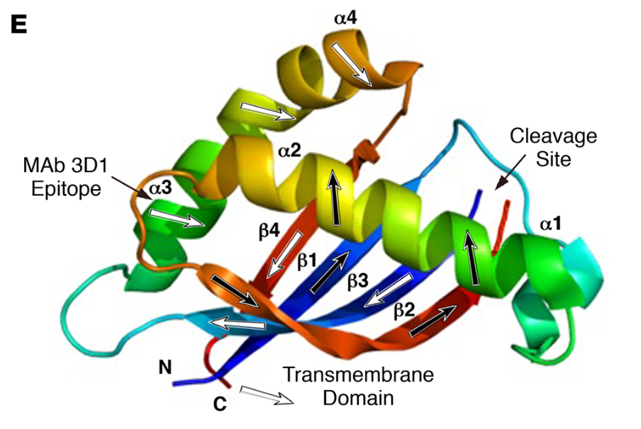
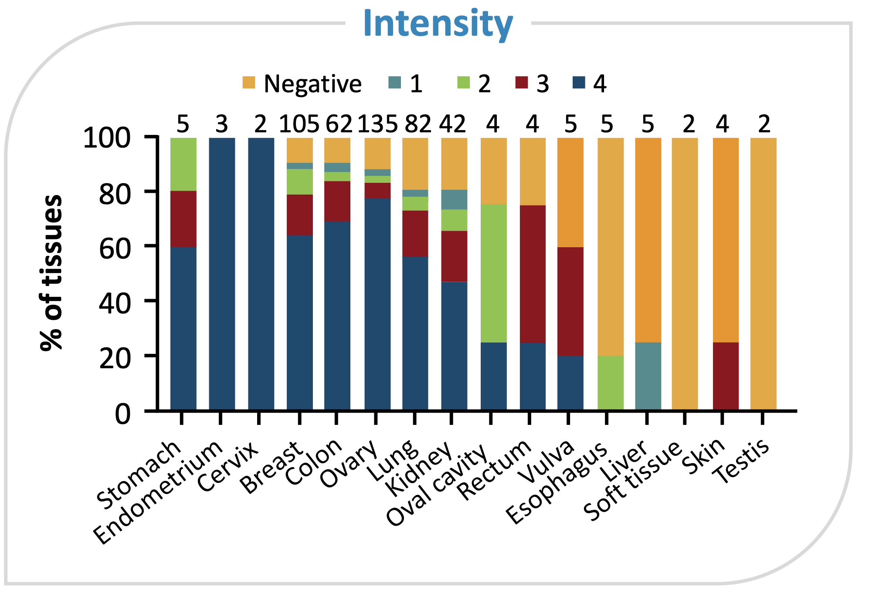
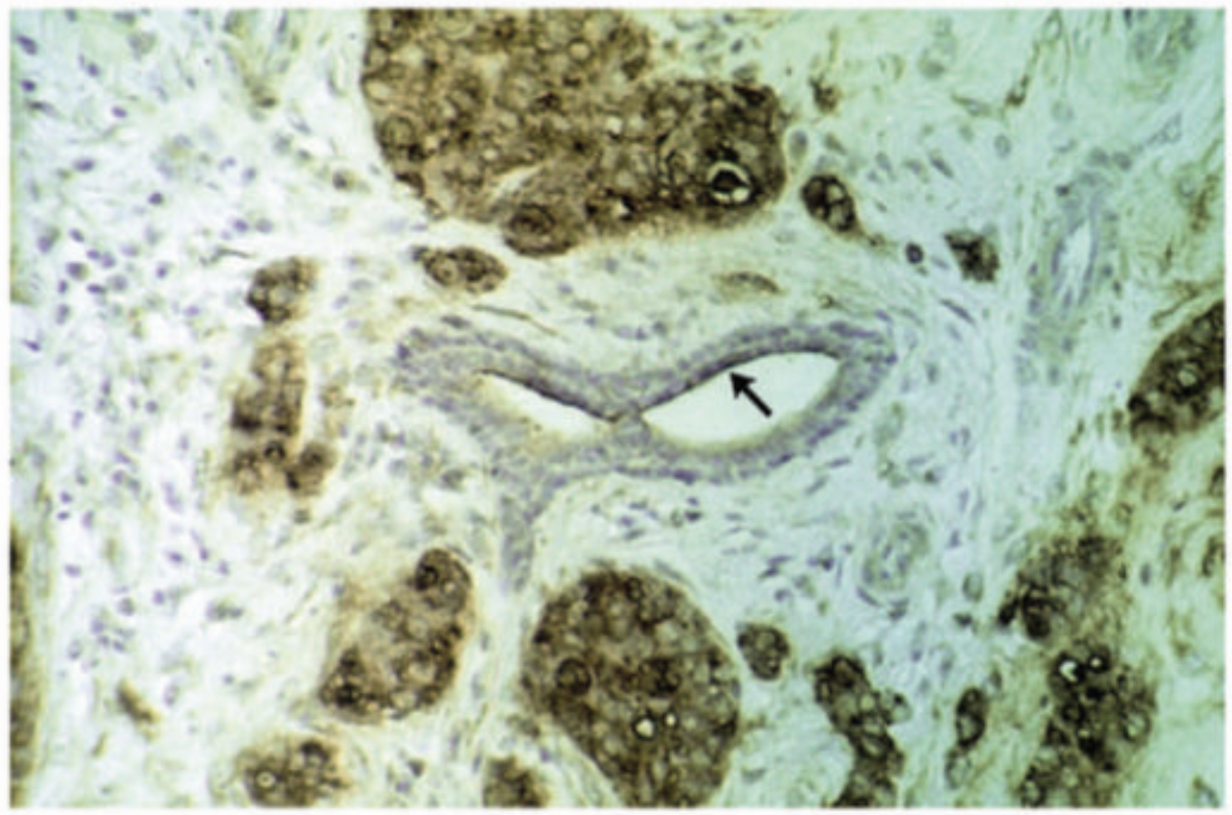
Multi-Cancer: MUC1-C tumor-selective antigen exposure & tumor-specific accessibility
Target Selection
Expression
Biology & Feasibility
Tumor-specific accessibility | ✓ | Tumor-specific antigen & accessibility
Internalization | ✓ | Natively internalized
Secretion | ✓ | Retained on cell surface
Ligandability | ✓ | mAb binding site can be used for peptide design
Apical membranous expression in healthy secretory epithelial cells
Upon malignant transformation:
1. Loss of polarization
2. Overexpression
3. Shedding of MUC1-N
4. Exposure of MUC1-C
5. MUC1-C internalization
MUC1-C Structure
mAb binding
MUC1-C overexpression in epithelial cancers
MUC1-C expression in Breast Cancer
Landscape
No MUC1-C RLT in development, to our knowledge
Sego’s Approach
Modality | MUC1-C peptide RLT
Positioning | 2L metastatic LUAD with the goal of replacing current salvage tx. May combine with PD-(L)1.
Apical membranous expression in glandular cells of the normal breast
Diffuse membranous and cytoplasmic expression in breast duct carcinoma
Sources: : : www.proteinatlas.org MUC1; Kufe 2013 Oncogene; Henry 2022, SITC; Panchamoorthy et al 2018 JCI Insight

Slide 3
Overview
MUC1 programs across modalities validate the target and inform RLT development
CAR-T & immunotherapy programs
ADC programs (clinical & preclinical)
Lessons for RLT from safety data
Poseida P-MUC1C-ALLO1 — Targets MUC1-C. Allogeneic CAR-T; Ph 1 in solid tumors; CRS Gr 1-2 dominant AE; no epithelial toxicity reported
Minerva huMNC2-CAR44 — Targets MUC1* (cleaved form). Autologous CAR-T; Ph 1/2 in breast, ovarian, NSCLC
PDS Bio PDS0103 — Targets TA-MUC1 (full-length). Versamune immunotherapy; IND cleared; breast/ovarian
Key signal: MUC1-C CAR-T shows predictable immune toxicity (CRS, cytopenias) without on-target epithelial toxicities — favorable for RLT
Biocytogen DM002 — Targets MUC1-C/ED. HER3×MUC1 bispecific ADC; Ph 1 initiated late 2024; MMAE payload
XYone 3D1-MMAE — Targets MUC1-C. Selective ADC; preclinical; no toxicity in MUC1-transgenic mouse models
Daiichi DS-3939a (DXd) — Targets TA-MUC1 (full-length). Ph 1/2; ILD ~10% (payload-driven); neutropenia, GI toxicity
Merck/Sutro M1231 — Targets TA-MUC1 (full-length). MUC1×EGFR bispecific ADC; hemiasterlin; NSCLC, ESCC
SPARC SBO-154 (MMAE) — Targets MUC1-SEA (full-length). Ph 1 dose escalation underway; advanced solid tumors
DAC DXC-005 (Tubulysin) — Targets full-length MUC1. Ph 1 in China
No obvious epithelial toxicities— across all MUC1 modalities (ADC, CAR-T, bispecifics), no clinical evidence of on-target epithelial toxicity
ADC toxicities are largely payload-driven — hematologic AEs, ILD, and GI effects track with payload class (DXd, MMAE), not with MUC1 binding
CRS dominates immune formats — Gr 1-2 CRS is manageable; not expected to translate to RLT
MUC1-C has differentiated therapeutic window — Targeting the anchored C-terminal subunit MUC1-C, rather than the shed, circulating N-terminal domain, achieves higher therapeutic efficacy.
RLT advantage: radiation payload avoids payload-class ADC toxicities (no ILD, no hematotoxicity from MMAE/DXd); MUC1-C selectivity limits off-tumor irradiation
Sources: ClinicalTrials.gov; Company disclosures; Biochem PEG MUC1 ADC landscape (2025); JCI Insight (2018); AACR 2024-2025, Beacon Intelligence
Confidential 3

Slide 4
MUC1-C Detailed Evaluation
Confidential 4

Slide 5
Summary: High tumor specificity makes MUC1-C an exceptional target for RLT
Biology
Mucin-1 (MUC1) is a heterodimeric transmembrane protein of the mucin family, heavily glycosylated and protecting epithelial surfaces. MUC1-N, the N-terminal subunit, contains variable 20-aa tandem repeats, modified by O-linked glycans. The C-terminal subunit (MUC1-C) includes a small extracellular domain, a TM domain, and a cytoplasmic tail. On the cell surface, MUC1-N is tethered to MUC1-C via hydrophobic interactions.
MUC1 is usually located on the apical membrane of secretory epithelial cells in the lung, GI tract, breast, and female reproductive tissues. Malignant transformation causes loss of cell polarity, shedding of MUC1-N into mucus, exposure of MUC1-C, and redistribution of MUC1-C from the apical surface to the entire cell membrane. MUC1-C is overexpressed and depolarized in many epithelial cancers (lung, breast, prostate, GI).
MUC1-C subunit can be bound specifically by mAbs and peptides (e.g., peptidomimetic SAG602). The MUC1-C extracellular domain (ED) has been crystallized in complex with antibodies, making the development of peptide binders to the MUC1-C ED highly feasible.
Lung cancer is projected to be the leading cause of cancer death, ~105,000, in the US. Lung Adenocarcinoma (LUAD) accounts for ~45% of all lung cancer cases. Roughly 40% to 60% of all metastatic NSCLC patients (including LUAD) do not currently have a clinically "actionable" driver mutation. Because MUC1-C is overexpressed in ~87% of these cases and drives resistance to standard agents, it is a high-priority target. Therapeutic approaches: CAR T cells and vaccines.
Expression
Feasibility
Landscape
Sego’s Opportunity
A MUC1-C specific peptide RLT that is effectively internalized and accumulated to achieve high tumor uptake and retention, resulting in superior antitumor efficacy against a tumor-selective, consistently overexpressed target.
Confidential 5

Slide 6
Biology
MUC1-C: tumor-selective antigen expression and tumor-specific accessibility
Apical membranous expression in secretory epithelial cells of healthy tissue
Upon malignant transformation:
1. Loss of polarization
2. Overexpression
3. Shedding of MUC1-N
4. Exposure of MUC1-C
Apical membranous expression in glandular cells of the normal breast
Diffuse membranous and cytoplasmic expression in breast duct carcinoma
Foci of breast carcinoma cells surrounding normal ducts
Adapted from: : www.proteinatlas.org MUC1; Kufe 2013 Oncogene; Grewal and Kurzrock 2025 NPJ PecisOncol
Confidential 6
Notes:
IHC: MUC1 or Muc1C
Homodimerization and internalization
Similar to some of the previous targets, MUC1-C expression is tumor-selective; in healthy tissue MUC1-C expression is restricted to the Apical membrane – meaning it is not accessible for RLT
During malignant transformation, cells lose polarization, MUC1 gets overexpressed on the entire cell
The N-terminal subunit gets shedd and the membrane anchored MUC1-C is know exposed
That allows MUC1-C to homodimerize and internalize/ recycle
Act as a oncoprotein to promote proliferation
Resistance to TKI
Immune evasion (upregulate PD-L1) and suppress INF-gamma
Right: IHC of invasive breast carcinoma, to illustrate the apical expression in healthy duct – would not be accessible for RLT
And the depolarized overexpression in the carcinoma that would be accessible for RLT

Slide 7
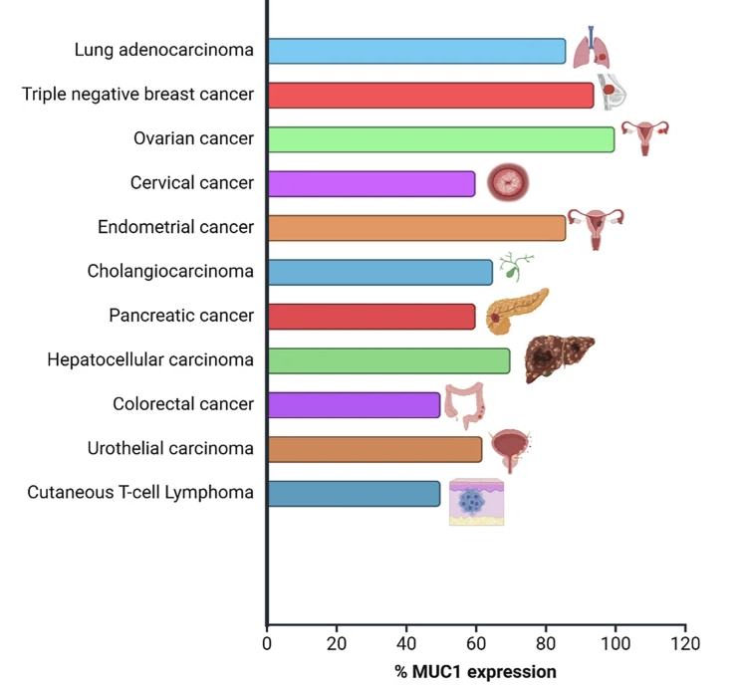
Expression
MUC1-C overexpression creates treatment opportunities in lung and beyond
MUC1 (full-length) is overexpressed in epithelial cancers
MUC1-C expression profile is consistent
86% of lung AC, 94% of TNBC, 100% of ovarian cancers
Stained with MUC1-C specific scFv
Sources: : www.proteinatlas.org MUC1; Kufe 2013 Oncogene; Grewal and Kurzrock 2025 NPJ PecisOncol; Henry 2022, SITC
Confidential 7
Notes:
Lots of IHC data on overexpression of MUC1 in cancers, very high in lung, breast and ovarian cancer
however it is not always clear if the N, the C or the intracellular domain is targeted,
however, there are also studies looking specifically at MUC1-C that show that the expression patterns correlate

Slide 8
Expression
MUC1-C is consistently & frequently overexpressed in epithelial cancers
Tumor expression levels
Indication | Type | Method | Criteria | Value | Source
LUAD | Protein/ MUC1-C | IHC | Percent positive and intensity (score 1-4) | 81% lung, n=82; ~90% breast, n=105; 88% ovary, n=135; 81% renal, n=42 | Henry 2022 SITC
LUAD | Protein / MUC1 | IHC | H-score | 100% pos, H-score: 285.9; n=64 | Cui 2024 Front Oncol
LUAD | Protein/ MUC1 TR | IHC | Positive case/no of cases | 100% pos, n=13 | Lopez-Ferrer 2001 Am.J.Respir.
 | Protein/ MUC1 | IHC | % positive cases | 87%, n=31 | Lakshmanan 2015, J Thorac Oncol
Breast | Protein/ MUC1 | IHC | % of tumor cells positive | 76.2% MUC1 positive; 24% ≥75% pos; 24% =50-75% pos; 29% =11-49% pos; n=21 | Wu 2018 Theranostics
 |  | IHC | H-score | 100% pos; h-score: 249.6; n=20 | Cui 2024 Front Oncol
CRC | Protein/ MUC1 | IHC | H-score | 97.6% pos, h-score: 158.3; n=83 | Cui 2024 Front Oncol
Healthy tissue expression
 | Type | Method | Criteria | Value | Source
All | Protein | IHC | HPA Medium or High | Glandular cells and respiratory epithelial cells. Cytoplasmic and apical membrane expression. | www.proteinatlas.org
All | mRNA | RNAseq | nPTM>10 | High in stomach (998.2), lung (309.6) and kidney (416.9) | www.proteinatlas.org
Confidential 8
Notes:
the stomach (998.2), lung (309.6),
So this table summarizes both MUC1 and mUC1-C

Slide 9
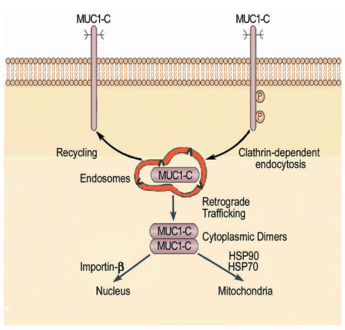
Biology
MUC1-C biology provides a strong rationale for radioligand targeting
Structure & Function
MUC1-C Internalization
Mucin 1 (MUC1) is a type I-transmembrane glycoprotein that is cleaved into two distinct subunits, which remain linked as a heterodimer on the cell surface.
MUC1-C, C-terminal subunit; extracellular region, transmembrane domain, and cytoplasmic tail.
MUC1-N, highly glycosylated extracellular subunit, variable number of tandem repeats (VNTRs).
Normal epithelial cells express MUC1 at low levels, localized exclusively to the apical surface.
Cancer cells: overexpression, loss of polarization, and release of MUC1-N make MUC1-C a tumor-specific epitope.
MUC1-C is minimally glycosylated and retained on the cell membrane, distributed over the entire cell surface.
Malignant cells internalize MUC1-C.
MUC1-N shedding is a key pathological event in cancer, leaving the MUC1-C subunit behind and membrane-bound.
The loss of MUC1-N leaves MUC1-C free to homodimerize, internalize and activate oncogenic pathways.
MUC1-C Structure
MUC1-C oncoprotein
Function: promotes survival, proliferation, and invasion.
mAb binding
MUC1-C is a driver of resistance to EGFR inhibitors (e.g., Osimertinib) and immune evasion (upregulation of PD-L1, suppression of IFN-ɣ).
RLT has a combination potential.
Sources: Kufe 2020 Carcinogenesis; Grewal and Kurzrozk 2025 NPJ Precis Oncol; Tong 2024 J Cancer; Chen 2021 Int J Mol Sci
Confidential 9
Notes:
MUC1-C is a premier candidate for radioligand therapy (RLT)
because its biological profile resolves the two greatest hurdles in nuclear medicine: target accessibility and biological stability. And internalization
Also provides the opportunity for RLT synergy with immunotherapy or TKI

Slide 10
Landscape
Significant market opportunity for a MUC1-C RLT across diverse set of indications
Lung Adenocarcinoma
Breast HR+/HER2-
Breast TNBC
CRC
Incident Pts (US) | 105,000 | 225,000 | 34,000 | 154,000
% Metastatic at diagnosis | ~50% | ~31% | ~21% | 60%
No actional driver mutations | 50-60% | n/a | n/a | n/a
Advance to 2L therapy | 33% | 91% | 87% | 74%
% MUC1C positive | 87% | 76% | 76% | 97%
TAM estimate: MUC1C RLT patients | ~11,000* | ~48,000 | ~4,700 | ~66,000
*Incident metastatic pts only. Does not include recurrent metastatic patients, which would increase TAM
n/a: Not shown for general estimate, will be evaluated as clinical strategy evolves
Sources: SEER, ACS Lung Stats, ACS Breast Cancer Stats, ACS CRC Stats, CDC, Cancer Advisor, Blondeaux 2025, Tampellini 2017
Confidential 10
Notes:
Metastatic LUAD without a driver mutation: PD-L1 status dictates SOC
MUC1-C is a driver for resistance to TKI
MUC1-C upregulates PD-L1 and suppresses INF-gamma – synergy with IO

Slide 11
Landscape
Example Target Product Profile for MUC1-C RLT in Lung Adenocarcinoma
Mechanism / Mode of Action | MUC1-C targeted peptide ligand conjugated to chelated ²²⁵Ac, delivering targeted alpha radiation post 1L IO + platinum chemotherapy
Clinical Trial Design | Randomized Phase III. MUC1-C-RLT vs. standard chemotherapy
Indication / Target Patients | Advanced/metastatic NSCLC patients with rwDOR ≤6 months on 1L IO +/- platinum chemo (exclude those with actionable driver mutations)
Dosing Regimen & Administration | Intravenous infusion of MUC1-C RLT for 4 doses, 4 weeks apart, and 2 doses every six months following the initial cycle until progression
Clinical Endpoints | Median OS >8.3 months (vs 5.1-5.2 months in primary resisters) Improved mOS, PFS, ORR vs standard chemotherapy
Efficacy |  | MUC1-C RLT | Docetaxel ± ramucirumab
 | Dosing Schedule | See above | 21 Days, Medical 4 cycles
 | mOS | >8.3 months | 5.2 months
 | DOR | >8 months | 6.4 months
 | ORR | > 30% | 22.9%
Safety / Tolerability | Grade 3-4 neutropenia Grade ≥3 TEAEs Treatment discontinuation Grade 3-4 neuropathy | ≤25% ≤50% ≤8% ≤2% | 55% 80% 18-22% 7-10%
Confidential 11

Slide 12
Opportunity
Sego’s differentiated approach to MUC1-C
 | Sego’s Approaches
 | Internalized cyclic peptide
Modality | Cyclic Peptide Targeting MUC1-C domain
Isotope | ²²⁵Ac or ¹⁶¹Tb
Internalization | Select for internalizing peptides to utilize increased cytotoxicity with internalized alpha- and beta/auger- emitters
Advantage | Improved tumor retention & ability to localize isotope intracellularly. Ability to leverage more cytotoxic isotopes with internalization. Diverse set of potential target tumors & indications.
Sources:
Confidential 12
Notes:
Summarize:

